Slide 1
Good morning everyone.
Please pull the latest files from the shared repo.
They are a copy of these slides and a new Jupyter notebook.
We will begin shortly.

Slide 2
Machine Learning in the Arts

Slide 3
Schedule
Check-In
Questions From Tuesday
Share Reddit Results
GPT-2 Overview
GPT-2 Examples
Generative Adversarial Networks (GAN) Overview
StyleGAN Intro & GAN Examples
Generative Visual Activity

Slide 4
Check-In
Is everyone doing alright?
Midterms go well?
Have anything exciting to share?
Other good news?

Slide 5
Any Questions?
Would anyone like to share the results of their generated reddit post?

Slide 6
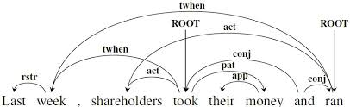
GPT-2 “The AI Too Dangerous to Release”
GPT-2 is a Transformer architecture
Transformers use an encoder and decoder. The encoder takes an input sequence and maps it to a vector space. The decoder is fed the abstract vector which turns it into an output sequence.
The output sequence can be another language, symbols, musical notes, a different type of image, etc.
Transformers are frequently used for language translation, document summarization, speech recognition, language comprehension, classification, etc.
The transformer’s big advantage comes through Attention.
Attention looks at an input sequence and decides at each step which other parts of the sequence are important.

Slide 7
GPT-2 “The AI Too Dangerous to Release”
1.5 billion parameters, trained on 8 million web pages, 40GB of internet text
A diverse dataset leads to the ability to generate text across many domains naturally (memes, research papers, novels, etc.)
On language tasks like question answering, reading comprehension, summarization, and translation, GPT-2 begins to learn these tasks from the raw text, using no task-specific training data.
“Due to our concerns about malicious applications of the technology, we are not releasing the trained model. As an experiment in responsible disclosure, we are instead releasing a much smaller model for researchers to experiment with, as well as a technical paper.”
Their concerns were mostly misleading news, propaganda, spam, and abusive content.
Staged release of the model over ~9 months starting with a 117M parameter model and ending with the full 1.5B parameter model.

Slide 8
GPT-2 Findings Since Release
Humans find outputs convincing. Cornell study found a “credibility score” of 6.91/10 for full 1.5B model.
774M model scored 6.72 and 355M model scored 6.07
GPT-2 can be fine-tuned for misuse.
Middlebury Institute of International Studies’ Center on Terrorism, Extremism, and Counterterrorism (CTEC) found that extremist groups can use GPT-2 for misuse.
Detection is challenging.
Developed in-house model with ~95% detection rate. This is not high enough accuracy for standalone detection and needs to be paired with metadata-based approaches, human judgment, and public education to be more effective.
Language models are inherently biased. Addressing and solving them is a challenge for the entire AI & ML community.
They saw no strong evidence of misuse so far.

Slide 9
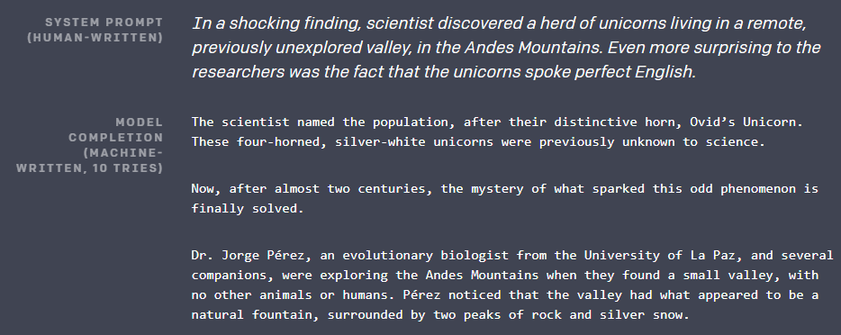
GPT-2 Examples

Slide 10
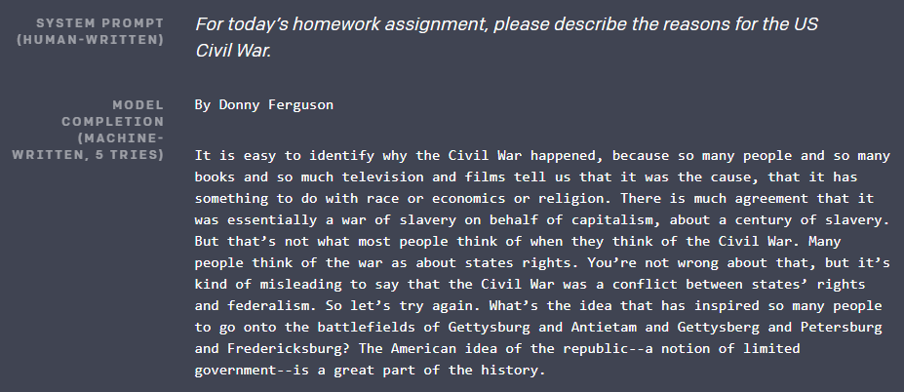
GPT-2 Examples

Slide 11
GPT-2 Examples
https://talktotransformer.com/

Slide 12
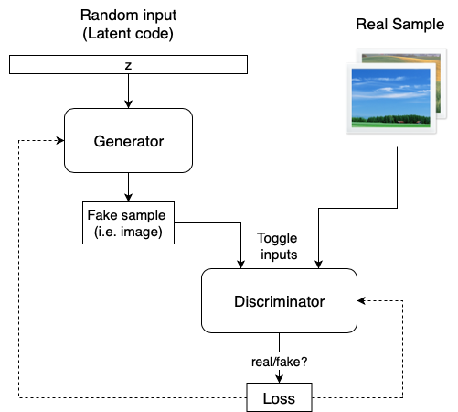
Generative Adversarial Networks (GANs)
GANs generate artificial samples in the medium they are trained on. (images, music, etc.)
GANs consist of two neural networks, a generator and a discriminator.
The generator produces artificial samples and the discriminator is tasked with determining if a sample is real or fake.
The generator input is a random vector (noise) and it transforms it into output. Its initial outputs are noise.
As the model trains the generator receives feedback from the discriminator and learns to produce more realistic images.
The discriminator also improves over time by comparing the generated samples with real samples.

Slide 13
Generative Adversarial Networks (GANs)
The generator can be imagined as a counterfeiter and the discriminator as the police tasked with catching the counterfeit money.
During training, the generator and discriminator go back and forth, pitted against each other.
For the generator to win it must produce counterfeit money that is indistinguishable from real.
Throughout this process the generator learns new techniques to produce more realistic images while the discriminator gets better at evaluating whether they are real or fake.
This game between the two introduces the adversarial learning of GANs.

Slide 14
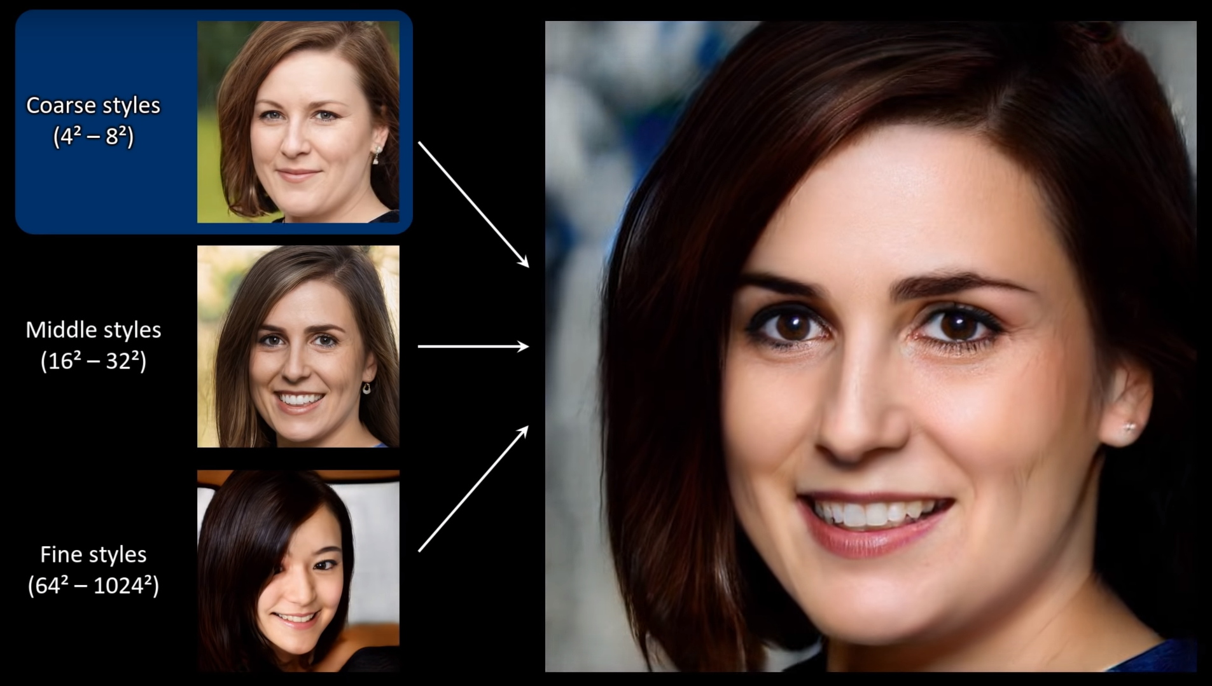
StyleGAN and its Improvements
Nvidia’s StyleGAN architecture, introduced in late 2018, and made open source in February 2019, proposed a different approach to generator architecture that was influenced by machine learning style-transfer literature.
It utilized progressive resolutions, from 4x4 up to 1024x1024.
This allows the model to influence specific features ar coarse, middle, and fine resolutions.
Coarse (4x4-8x28): high level aspects such as pose, general hair style, face shape, etc.
Middle (16x16-32x32): smaller scale features such as fine facial features, eyes open/closed, hair style
Fine (64x64-1024x1024): color scheme and micro features

Slide 15
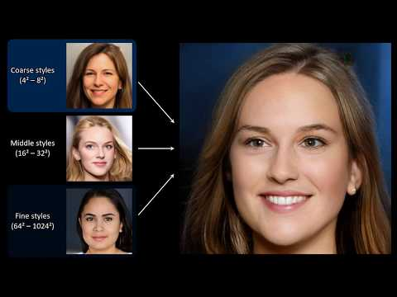
https://www.youtube.com/watch?v=kSLJriaOumA&feature=emb_title

Slide 16
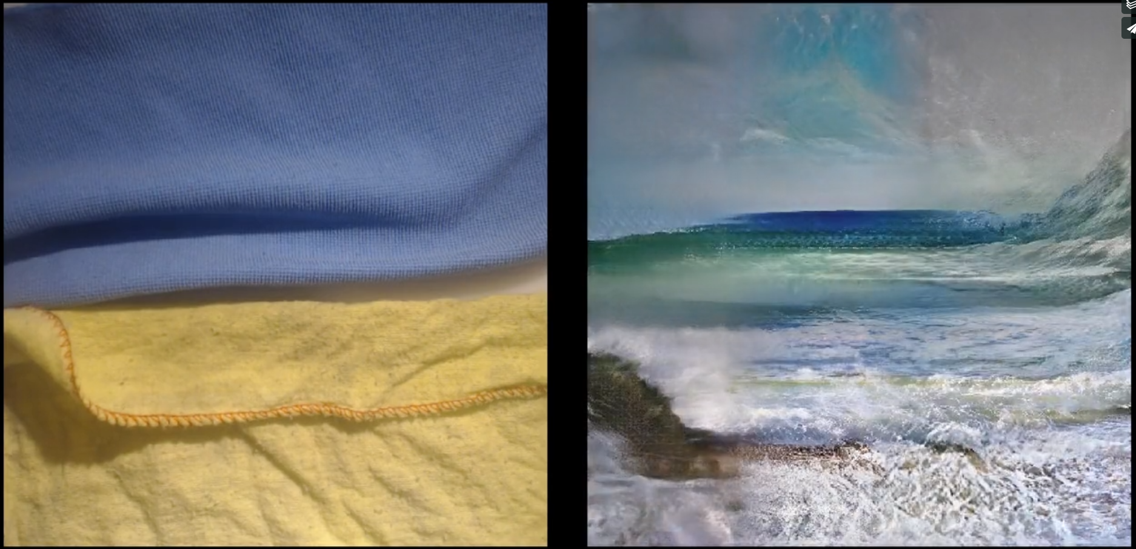
Learning to See
https://vimeo.com/260612034

Slide 17
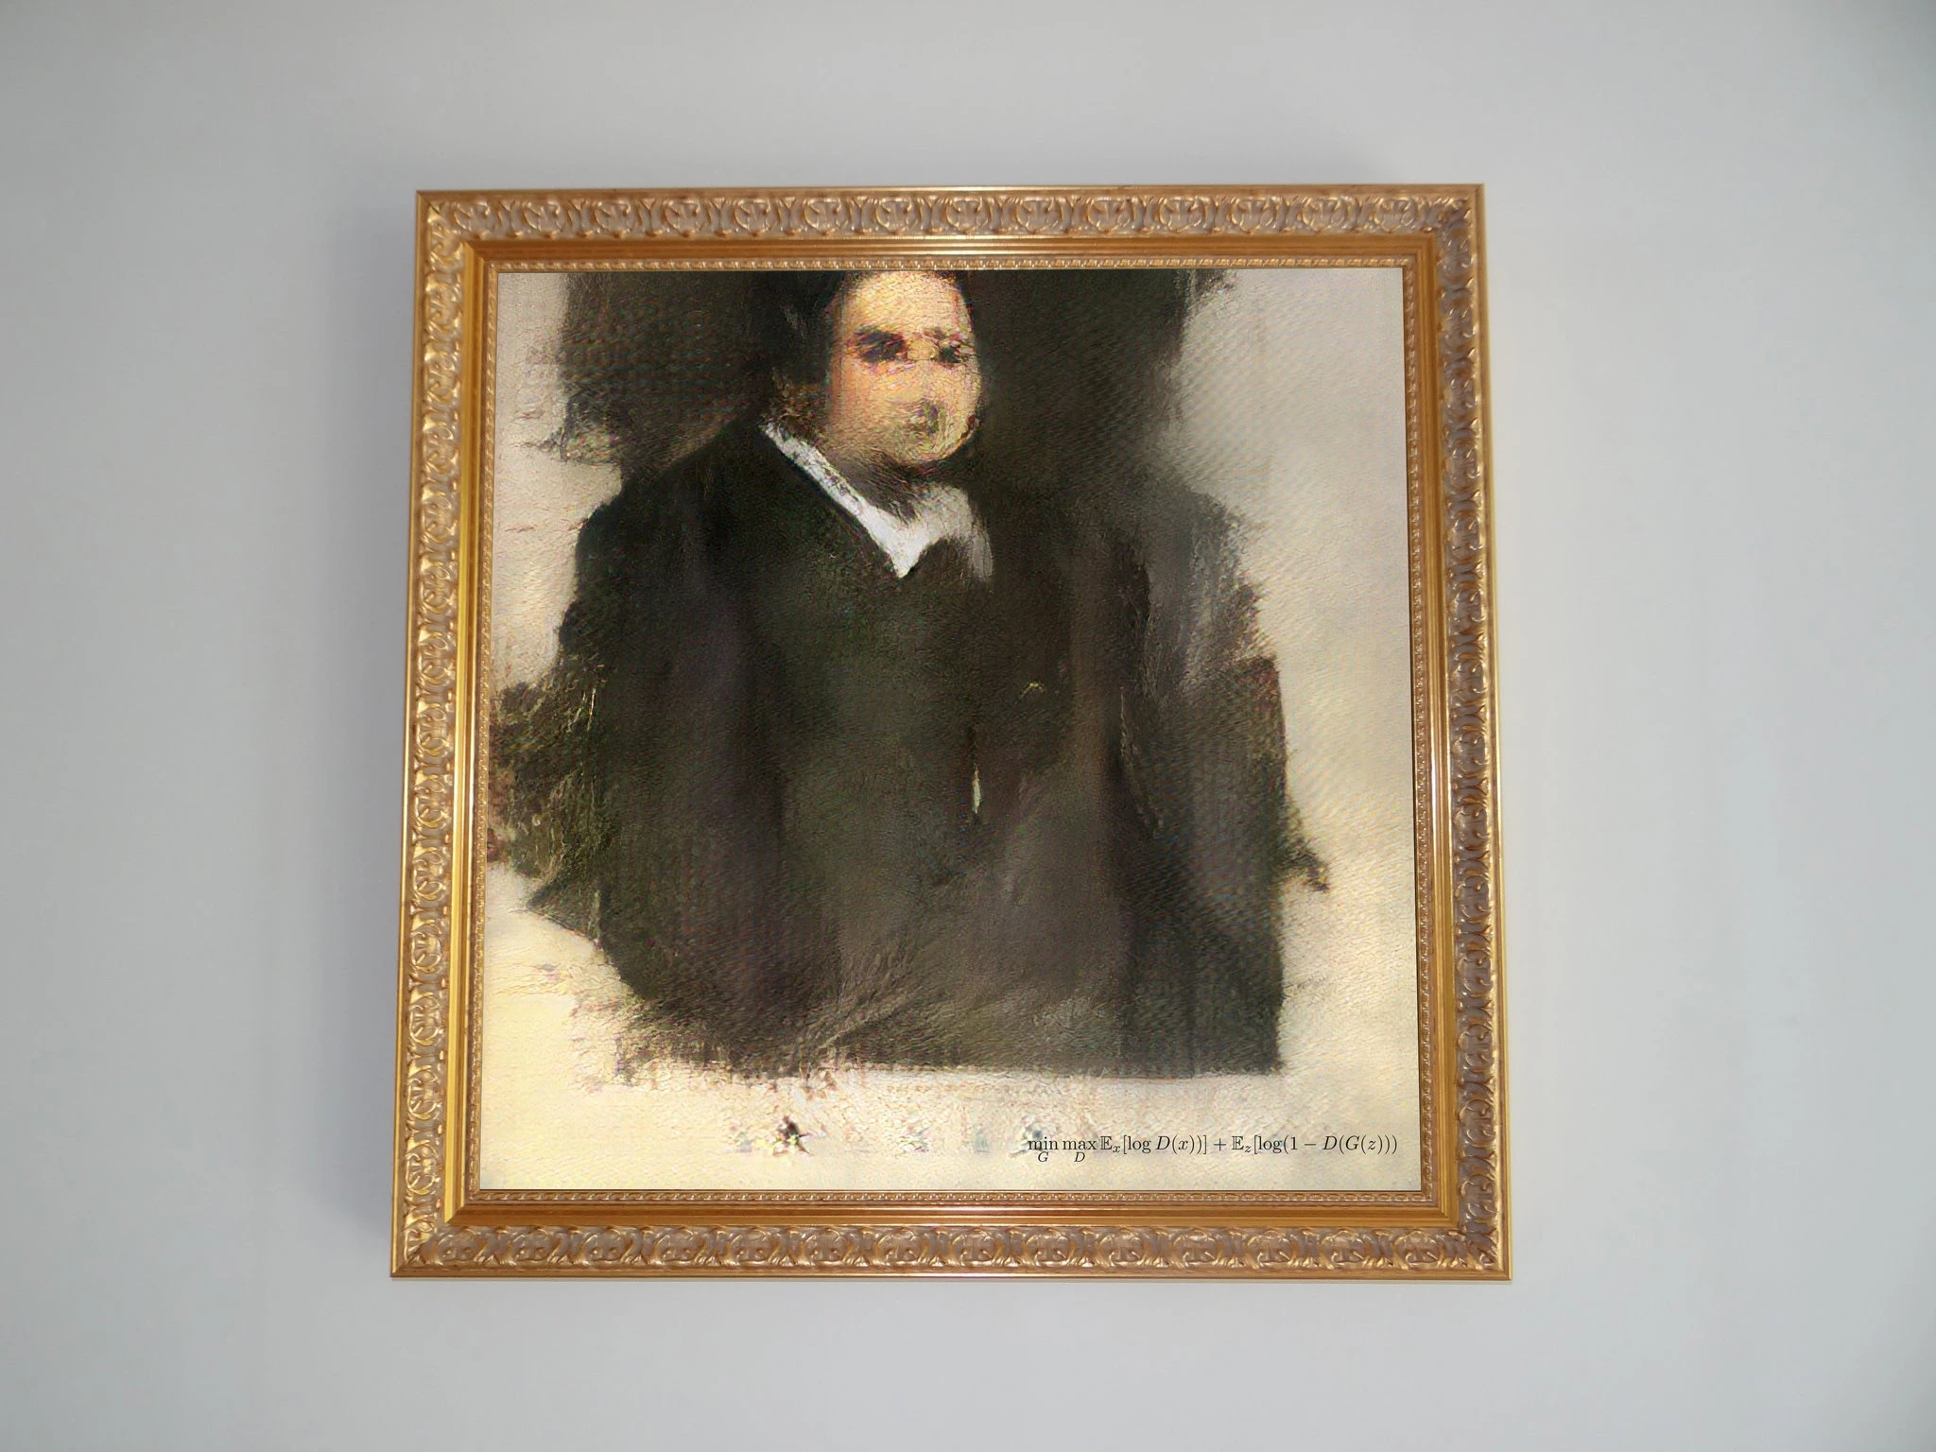
AI Art at Christie’s
Created by French art collective Obvious
Titled Portrait of Edmond Belamy
Was put up for auction at the Prints & Multiples sale at Christie’s in 2018
Hung across from an Andy Warhol print that sold for $75K
How much do you think this piece sold for?
$0-$100K
$100K-$250K
$250K-$500K
$500-$750K
$750K+
Was made using mostly borrowed open source code.
Again begs the question of who is responsible for this piece and what role did ML play?

Slide 18
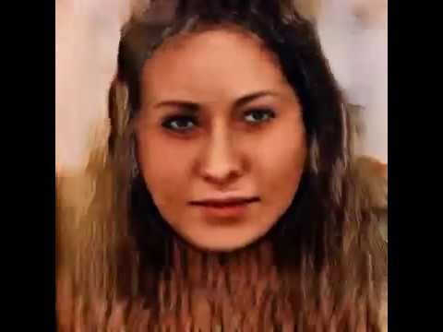
Freeda Beast - Bringing Things to an End
https://www.youtube.com/watch?v=nbB8_y6JpdA

Slide 19
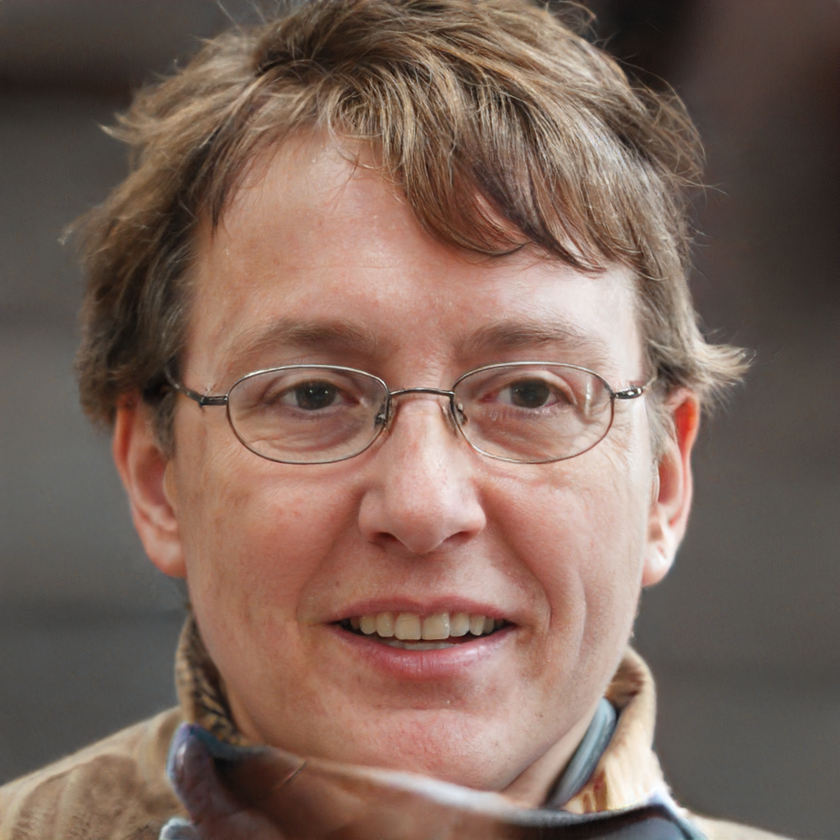
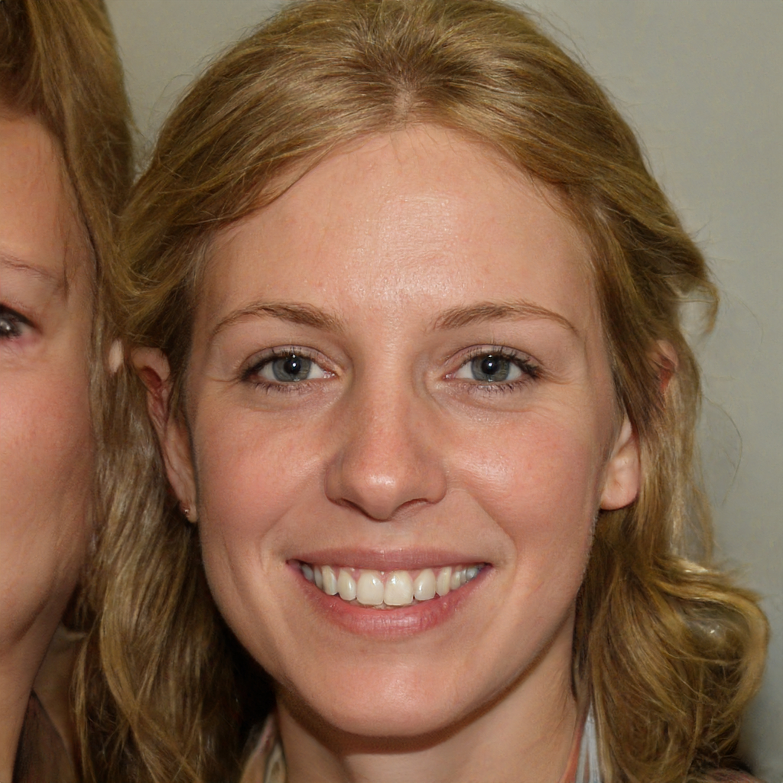
This Person Does Not Exist
https://thispersondoesnotexist.com/

Slide 20
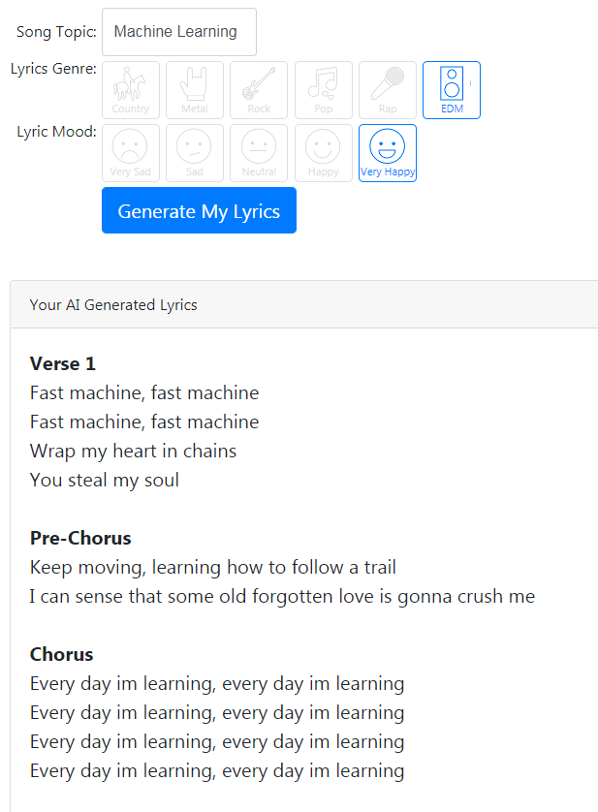
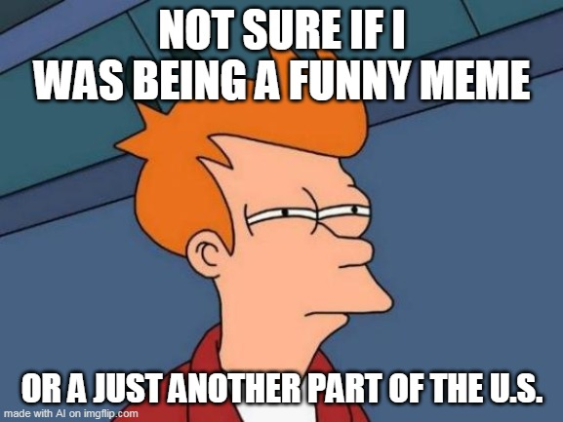
What Else Does Not Exist?
https://www.thiswaifudoesnotexist.net/
http://thesecatsdonotexist.com/
https://thiscardoesnotexist.glitch.me/
https://thisrentaldoesnotexist.com/about/
https://imgflip.com/ai-meme
https://thisxdoesnotexist.com/

Slide 21
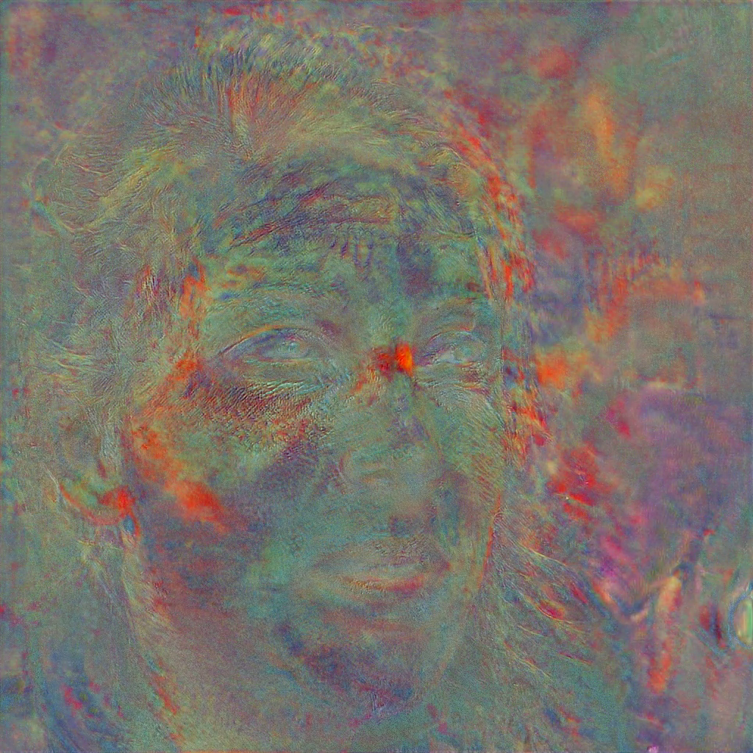
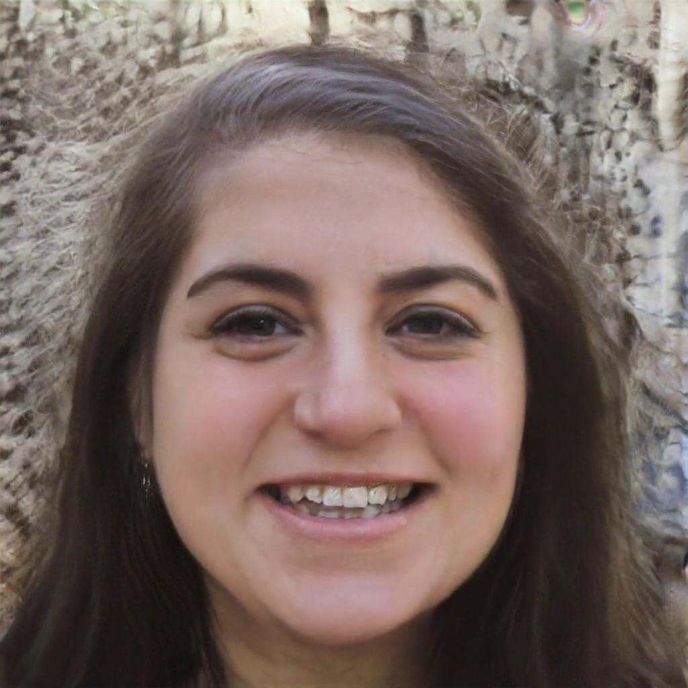

Slide 22
Generative Visual Activity

Slide 23
Generative Visual Activity
If you have not done so already please pull the latest files from the shared repo.
Go to Google Colab and import the new 196_Stylegan.ipynb notebook.
Runtime -> Change runtime type -> GPU

Slide 24
References
https://arxiv.org/abs/1706.03762
https://medium.com/inside-machine-learning/what-is-a-transformer-d07dd1fbec04
https://pathmind.com/wiki/attention-mechanism-memory-network
https://openai.com/blog/gpt-2-1-5b-release/
https://arxiv.org/abs/1406.2661
https://roberttwomey.github.io/ucsd-ml-art/
http://www.memo.tv/works/learning-to-see/
https://www.theverge.com/2018/10/23/18013190/ai-art-portrait-auction-christies-belamy-obvious-robbie-barrat-gans
https://www.nytimes.com/2018/10/25/arts/design/ai-art-sold-christies.html
https://github.com/NVlabs/stylegan

